Slide 1

Development of Ethernet communication interface for kintex-7 KC-705 FPGA board using VHDL
Guided by: Presented By:
Mr. Avanish Ojha Jasmine Jinwal
Mr. T. A. Puntambekar

Slide 2
Outline
Introduction
Open source technologies used
OSI model
TCP/IP protocol suite

Slide 3
Introduction
Indus 2 is a synchrotron radiation source of electron energy of 2.5 GeV and beam current of 200 mA. Measurement of electron beam position is being done using analog and digital beam position monitors.
Digital beam position monitors use gigabit ethernet communication for transfering FA position data.
In this project gigabit ethernet interface will be developed for Kintex-7 Kc705 FPGA Board.
In future the same code may be utilized for indegenious digital beam position monitors.

Slide 4
Kintex 7 KC-705 FPGA board
USB
Ethernet
Switch

Slide 5
Open source technologies to be used

Slide 6
Our goals are
Keep track of any changes we make
Maintain multiple versions of the same project
Clearly communicate what changes have been made
Why Git ?
Git is distributed
Git is powerful (more than CVCS)
Git is easier
Git is the DVCS

Slide 7
Git
Git is a free and open source distributed version control system designed to handle everything from small to very large projects with speed and efficiency.
The purpose of git is to manage a project, or a set of files, as they change over time.
It is a version control tool that will allow you to perform all kinds of operations to fetch data from the central server or push data to it.
It merges the code from different computers and different team members.

Slide 8
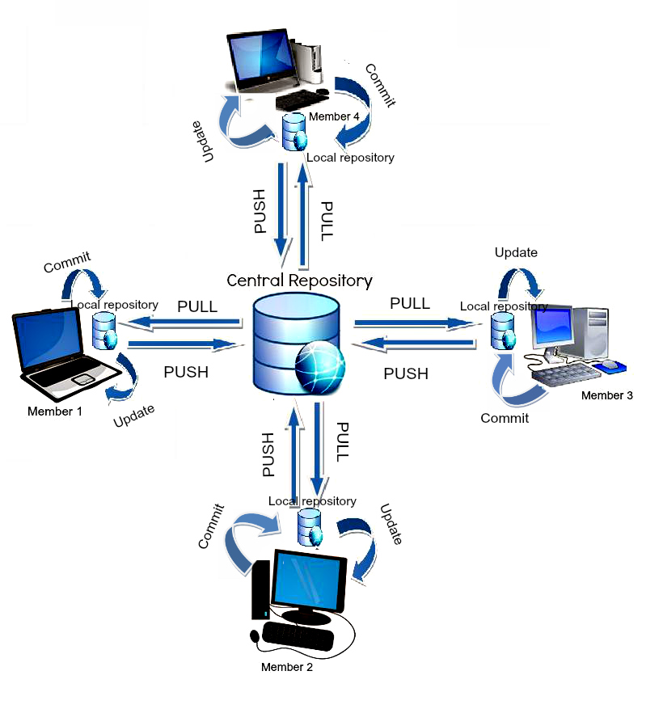
Working of a DVCS

Slide 9
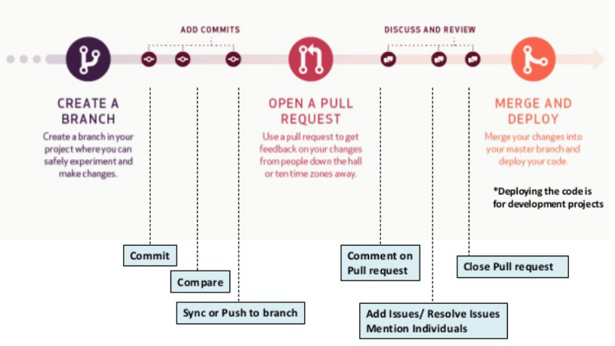
Github
Github is a web-based hosting service for version control using Git. It is mostly used for computer code.
It offers all of the distributed version control and source code management (SCM) functionality of Git as well as adding its own features.

Slide 10
Python
Python is a high-level, interpreted, interactive and object-oriented scripting language. It is designed to be highly readable.
Guido van Rossum created the Python programming language in the late 1980s.
In contrast to other popular languages such as C, C++, Java, and C#, Python strives to provide a simple but powerful syntax.

Slide 11
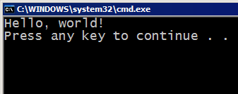



Compiling and interpreting
Many languages require you to compile (translate) the program into a form that the machine understands.
Python is instead directly interpreted into machine instructions.
compile
execute
source code
Hello.java
byte code
Hello.class
output
interpret
source code
Hello.py
output

Slide 12
Python versus C++
S.No | Python | C++
1 | It supports garbage collection. | It does not supports garbage collection
2 | It is easier to write | As compared to python the syntax is complex.
3 | Python runs with interpreter. | C++ is pre complied.
4 | Rapid prototyping is possible due to smaller code. | Rapid prototyping is not possible due to larger code.
5 | Easier to maintain,object oriented and simpler to use. | Less clean and manageable as compared to python .

Slide 13
OSI model

Slide 14
Open Systems Interconnection (OSI) Model
International standard organization (ISO) established a committee in 1977 to develop an architecture for computer communication. Open Systems Interconnection (OSI) reference model is the result of this effort.
The OSI model describes how information or data makes its way from application programs through a network medium (such as wire) to another application programs located on another network.
The OSI reference model divides the problem of moving information between computers over a network medium into seven smaller and more manageable problems . This separation into smaller more manageable functions is known as layering.

Slide 15
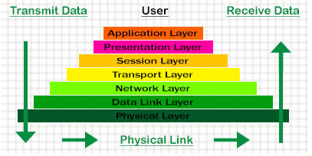
Layers of OSI model

Slide 16
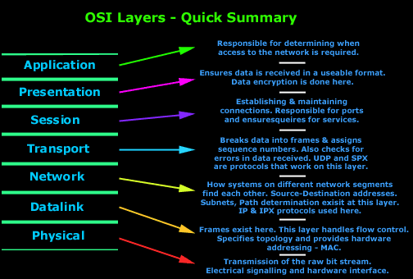

Slide 17
TCP/IP Protocol Suite

Slide 18
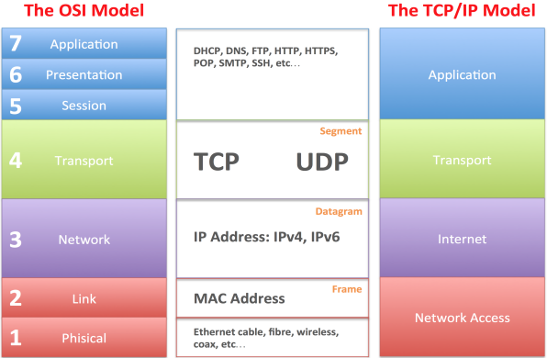
TCP/IP is a set of protocols developed to allow cooperating computers to share resources across a network.
TCP stands for “Transmission Control Protocol” and IP stands for “Internet Protocol”.
When TCP/IP is compared to OSI, we can say that the TCP/IP protocol suite is made of four layers: network interface, network, transport, and application.

Slide 19
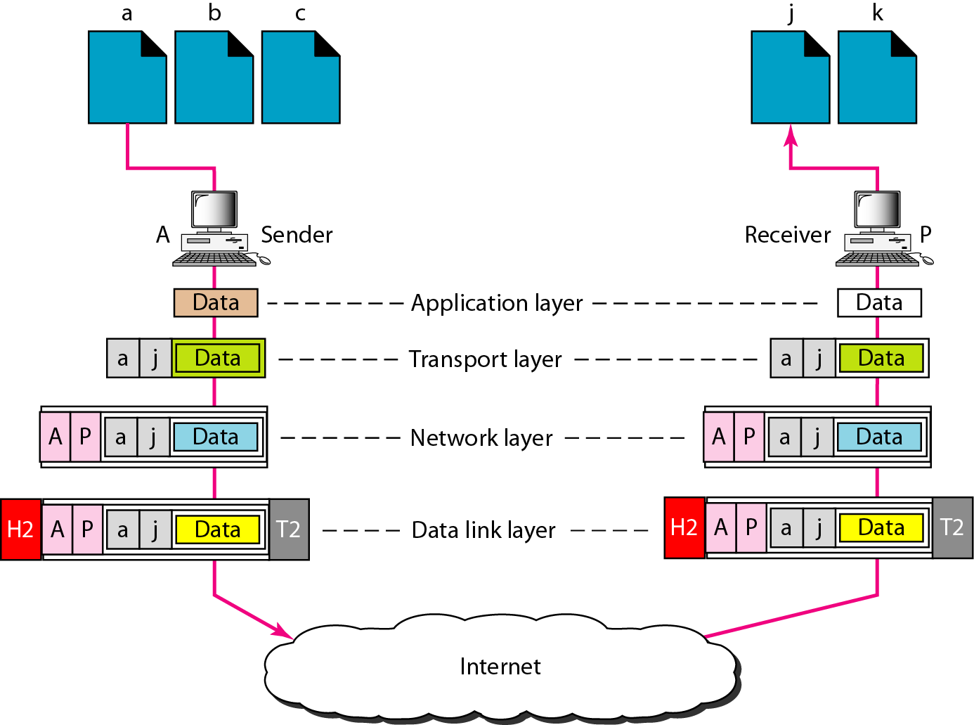
Communicating using internet

Slide 20
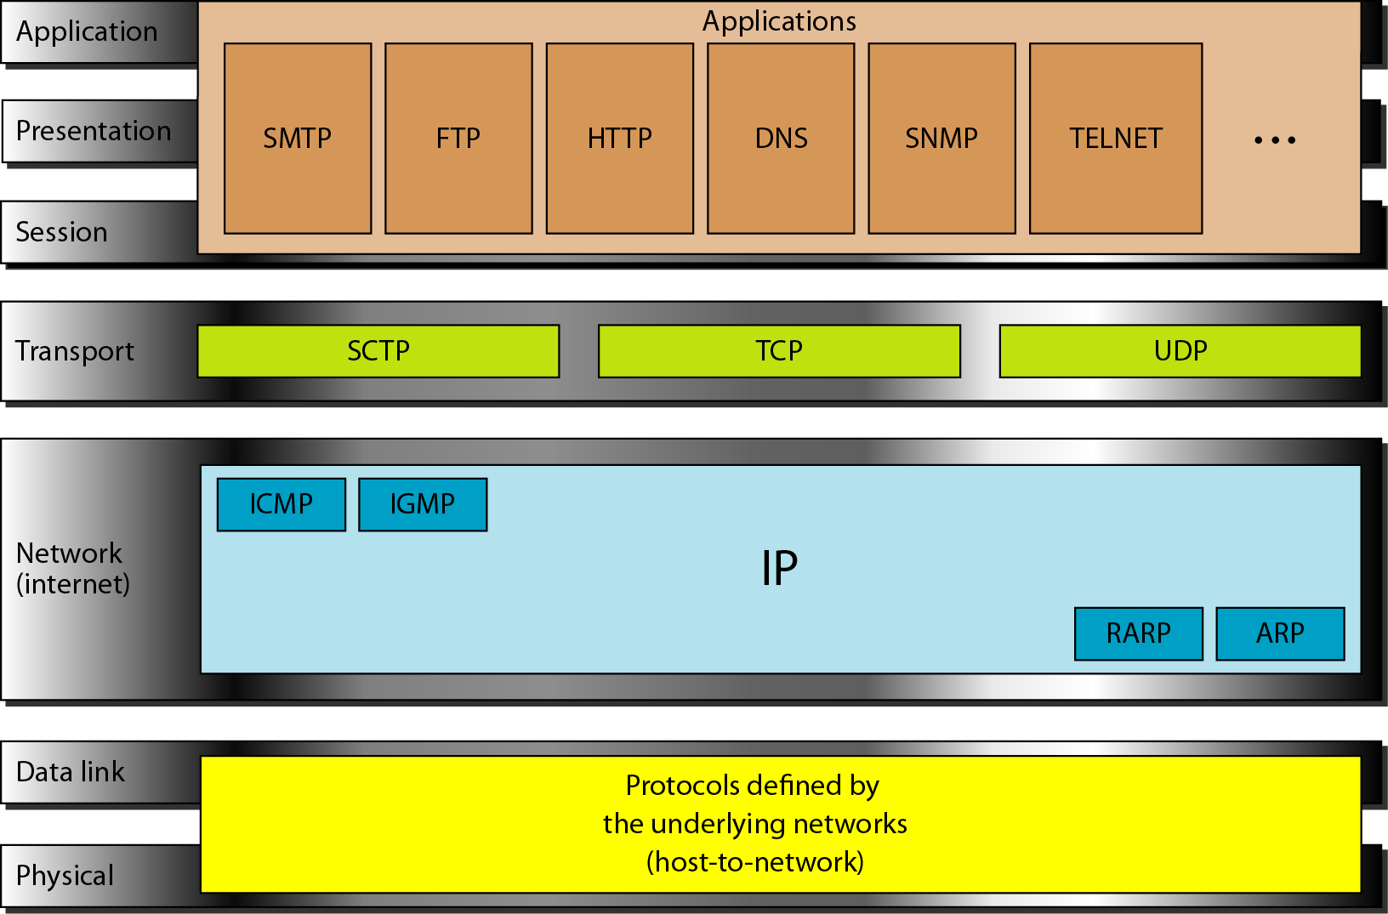
Link Layer : includes device driver and network interface card
Network Layer : handles the movement of packets, i.e. Routing
Transport Layer : provides a reliable flow of data between two hosts
Application Layer : handles the details of the particular application

Slide 21
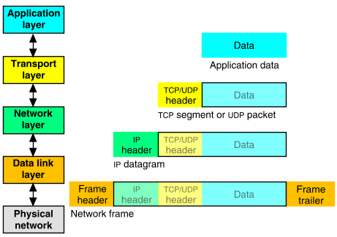
Packet Encapsulation
The data is sent down the protocol stack.
Each layer adds to the data by adding headers.
22Bytes
20Bytes
20Bytes
4Bytes

Slide 22
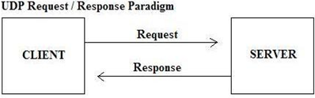
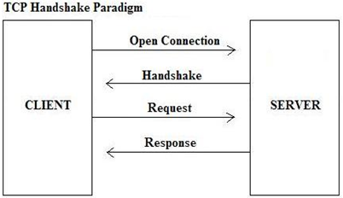
TCP and UDP

Slide 23
UDP Frame
Field Purpose_______________________
Source Port 16-bit port number identifying originating application
Destination Port 16-bit port number identifying destination application
Length Length of UDP datagram (UDP header + data)
Checksum Checksum of IP pseudo header, UDP header, and data
0
16
31
Source Port
Destination Port
Length
Checksum
Application data

Slide 24
TCP Frame
Field Purpose______________________
Source Port Identifies originating application
Destination Port Identifies destination application
Sequence Number Sequence number of first octet in the segment
Acknowledgment Sequence number of the next expected octet
Len Length of TCP header in 4 octet units
Flags TCP flags: SYN, FIN, RST, PSH, ACK, URG
Window Number of octets from ACK that sender will accept
Checksum Checksum of IP pseudo-header + TCP header + data
Urgent Pointer Pointer to end of “urgent data”
Options Special TCP options such as MSS and Window
0
4
10
16
19
24
31
Source Port
Destination Port
Sequence Number
Acknowledgment Number
Len
Reserved
Flags
Window
Checksum
Urgent Pointer
Options...
Padding
Data...

Slide 25
IP Addressing
IP stands for Internet Protocol. It is unique identifier for a computer or device on a TCP/IP network.
It is a 32-bit binary number usually represented as 4 decimal numbers separated by a period.
Example:
206 . 40 . 185 . 73
11001110.00101000. 10111001.01001001
Valid addresses can range from 0.0.0.0 to 255.255.255.255
A router is used to connect IP networks to minimize the amount of traffic each segment must receive.

Slide 26
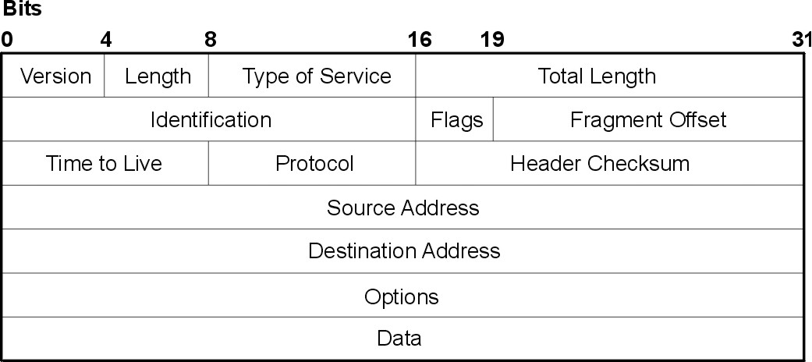
Each device on a node has a unique MAC address.
Each device on a node needs a unique IP address.
All devices on the same physical segment share a common network ID (subnet mask).
Each physical segment has a unique Network ID (subnet mask).

Slide 27
Address Resolution Protocol (ARP)
Before an IP packet can be forwarded to another host, the MAC address (Ex: 02-FE-87-4A-8C-A9) of the receiving machine must be known.
ARP determines the MAC addresses that correspond to an IP address.
A router will choose direct paths for the network packets based on the addressing of the IP frame it is handling (different routes to different networks).
Router
ARP
Request
Destination Host
Internet
Process
Internet
Process
ARP Response

Slide 28
Error Detection Method - Cyclic Redundancy Check
There are 2 types of errors- single bit error and burst error.
Cyclic Redundancy Check(CRC) is an error detection method in which a special number is appended to a block of data in order to detect any changes introduced during transmission.

Slide 29
Data plus extra zeros. The number of zeros is one less than the number or bits in the divisor.
CRC

Slide 30
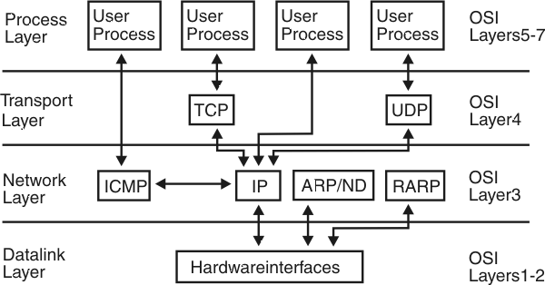
Connection of different layers of TCP/IP model

Slide 31
References
Andrew S. Tanenbaum and David J. Wetherall.Computer networks. 5th ed. Munich:Pearson Deutschland GmbH, 2012. ISBN: 978-3-86894-137-1.
https://developers.google.com/edu/python/
https://github.com/jrjohansson/scientific-python-lectures
https://raw.githubusercontent.com/pkerling/ethernet_mac_doc/master/Thesis.pdf
https://www.xilinx.com/support/documentation/boards_and_kits/kc705/ug810_KC705_Eval_Bd.pdf
https://www.wikipedia.org/

Slide 32


